Slide 1
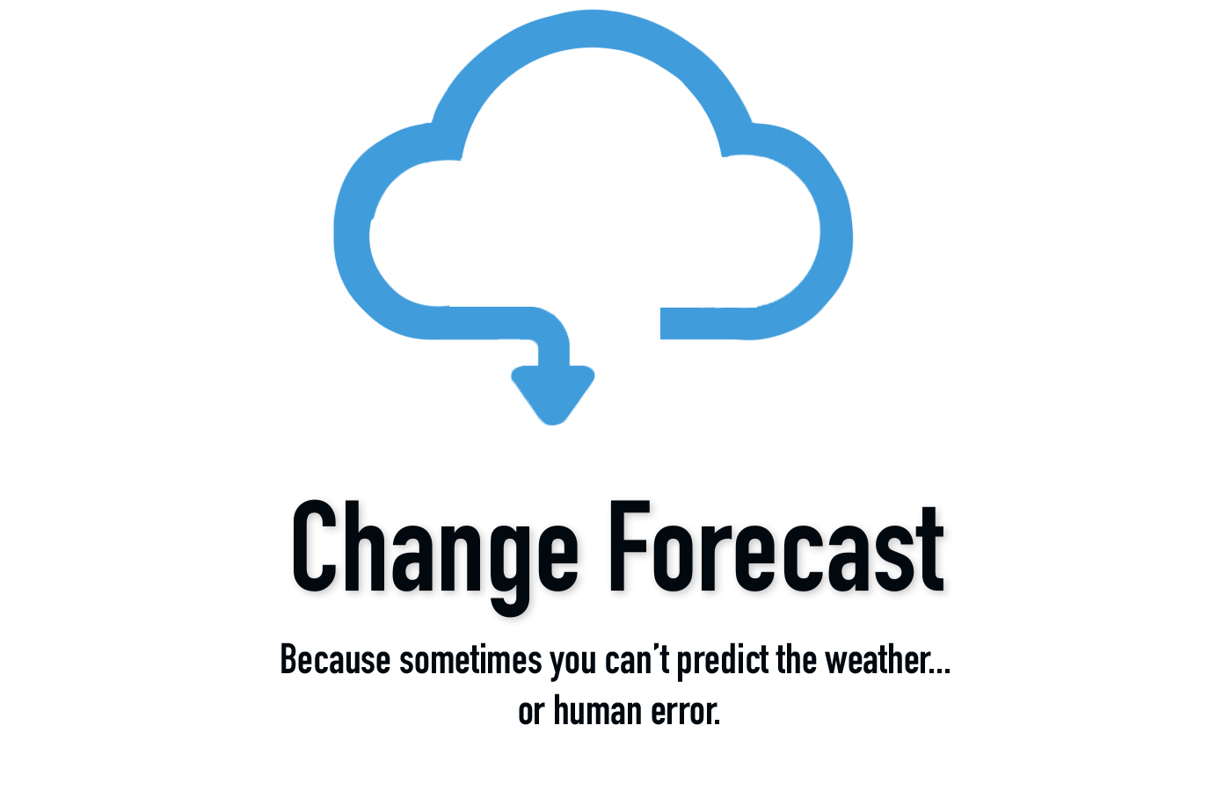
Change Forecast
G Dog and the Coding Ninjas

Slide 2
Overview
Introduction
Concept
Demo
Process
Future Development
Links
Questions

Slide 3
Change Forecast in 30 Seconds…
You are responsible for managing changes and you need a quick way to report on upcoming major change activity
The answer is Change Forecast
Provides a consolidated view of changes data and graphical views

Slide 4
Concept
Description
Motivation
User Story

Slide 5
A Demo of Change Forecast

Slide 6
Process
Technology
dotenv
env
Heroku
HTML/CSS/ Bootstrap
Google Fonts
JavaScript
Passport

Slide 7
Process (continued)
Breakdown of Tasks / Roles
Front-end/ Backend: G Dog and the Coding Ninjas
Issue Tracking and Tasks: Donna
Project Manager: Greg
PowerPoint: Denise, Dexter
Testing: G Dog and the Coding Ninjas

Slide 8
Process (continued)
Challenges
Determining how to generate the mock data
Getting the data from the database
Error handling
Finalizing website features
Successes
Great teamwork. Everyone contributed well. Great communication.
Productive project meetings
Scrum meeting earlier in the day, followed by a working meeting in the afternoon
Conducted weekend meetings to finalize project

Slide 9
Directions for Future Enhancements

Slide 10
Links
Deployed Application
LINK GOES HERE
GitHub Repository
https://github.com/gehanstedt/change-forecast

Slide 11
Questions?

Slide 12
Thank you!

